Slide 1
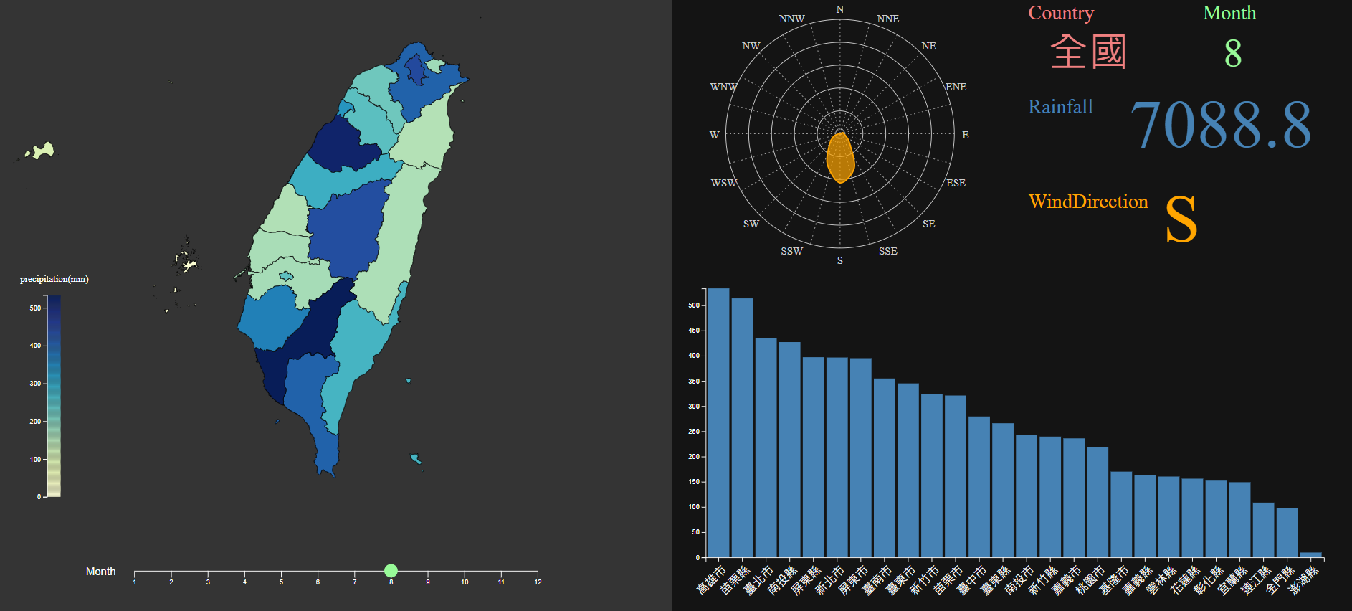
The Patterns of Wind Direction and Precipitation in Taiwan
資工115張辰瑜、資工115吳承霖

Slide 2

Dataset
taiwan.json
taiwan map
monthly rainfall
Calculate the total rainfall
in each month from daily data
weather data
monthly
wind direction
Statistic wind direction distribution
in each month from daily data

Slide 3


Usage scenarios & tasks
Serve as a teaching tool for teacher
to demonstrate the precipitation patterns
By this tool, students can better understand about
the weather phenomena in different seasons and regions, and the relation between rainfall and wind direction

Slide 4
Usage scenarios & tasks
compare regional differences in rainfall
observe map & bar chart
observe all the patterns
change by time
drag the point on
the time axis
observe all the patterns
of specific city
click the city on the map
compare the relation between rainfall and wind direction
observe radar chart with other chart

Slide 5
Visual Design
compare regional differences in rainfall

Slide 6
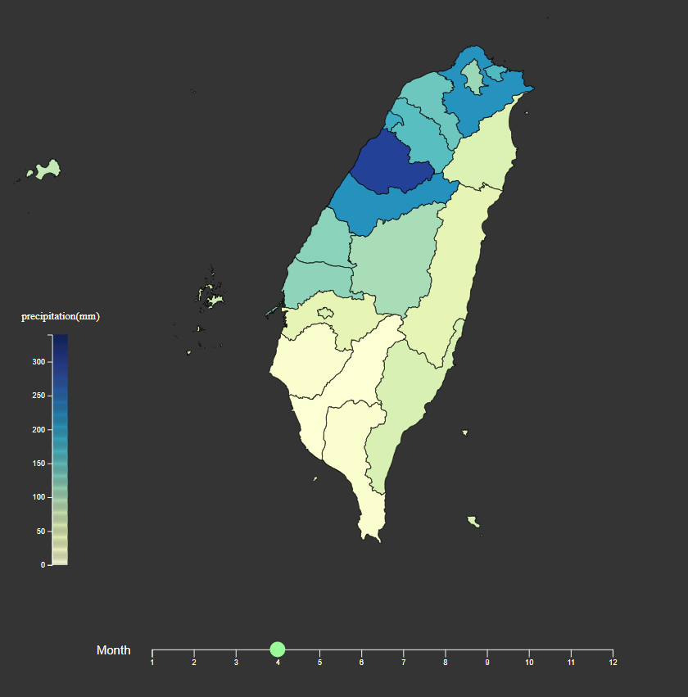
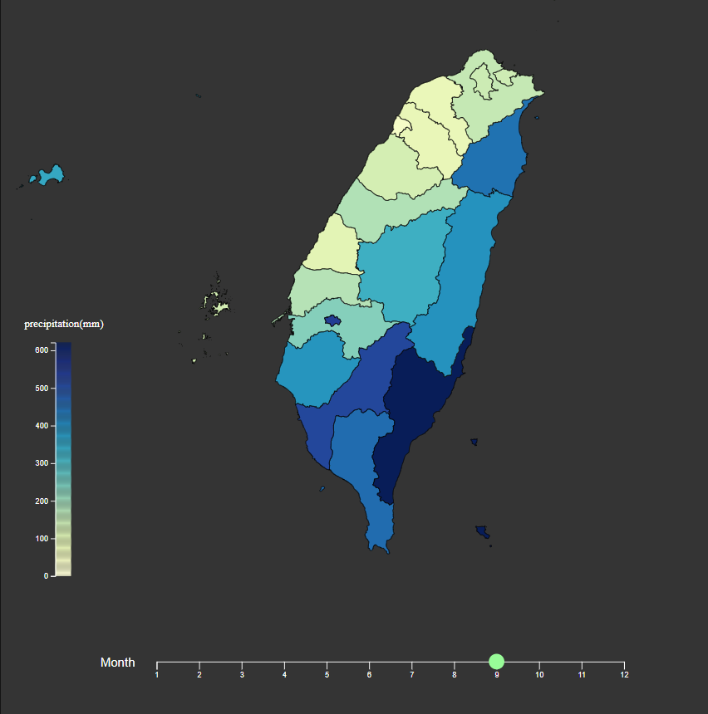
Visual Design
observe all the patterns change by time

Slide 7
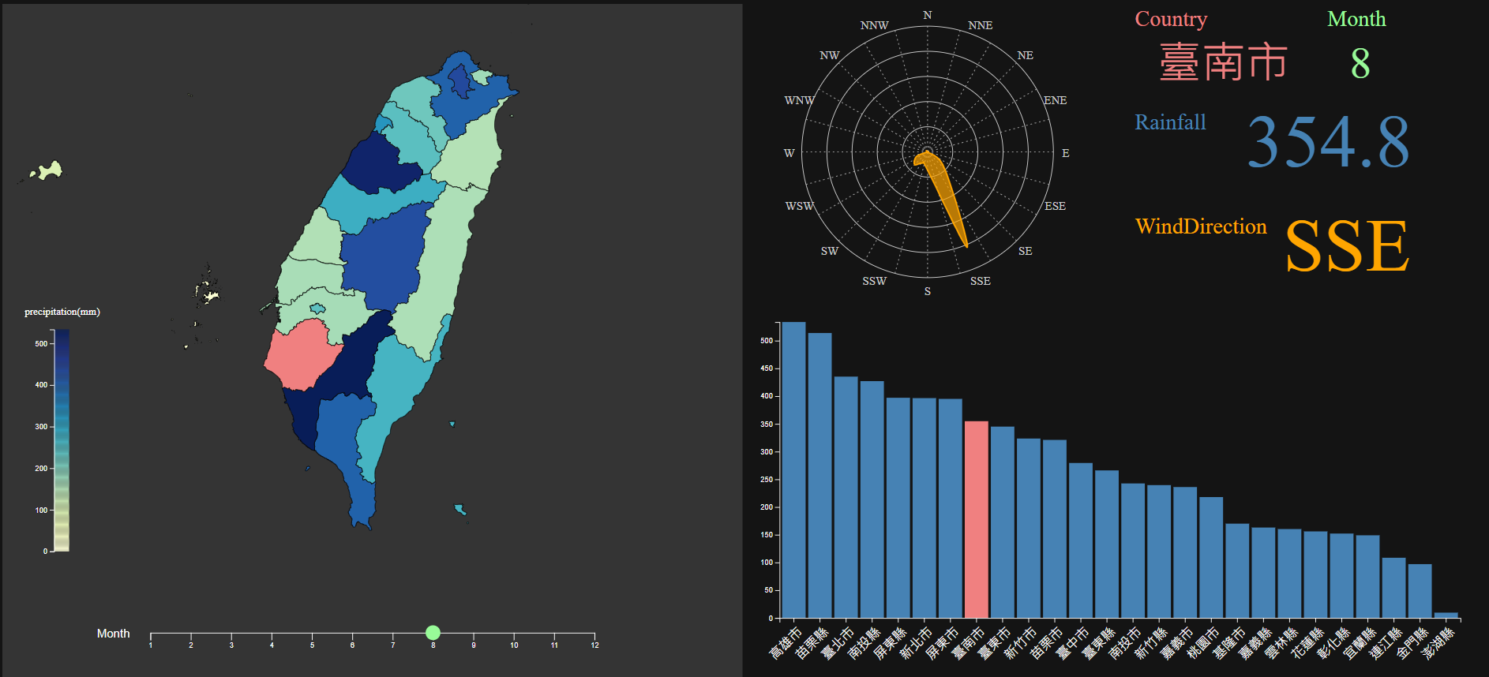
Visual Design
observe all the patterns of specific city

Slide 8
Visual Design
compare the relation between rainfall
and wind direction

Slide 9
Observation
Keelung is the city with most precipitation in winter
Northeast wind in winter is not that obvious as we thought
Kaoshiung becomes the only city with most rainfall of south Taiwan in August (due to typhoon)
The average wind direction throughout the year is south wind

Slide 10
Difficulties
the data timescale is too small
Misunderstanding of data time scale we need on the graph
Didn’t consider the number of sites in each city at first
Finding the relation of wind direction and precipitation
(we gave up)

Slide 11
Thank you !

